Slide 1
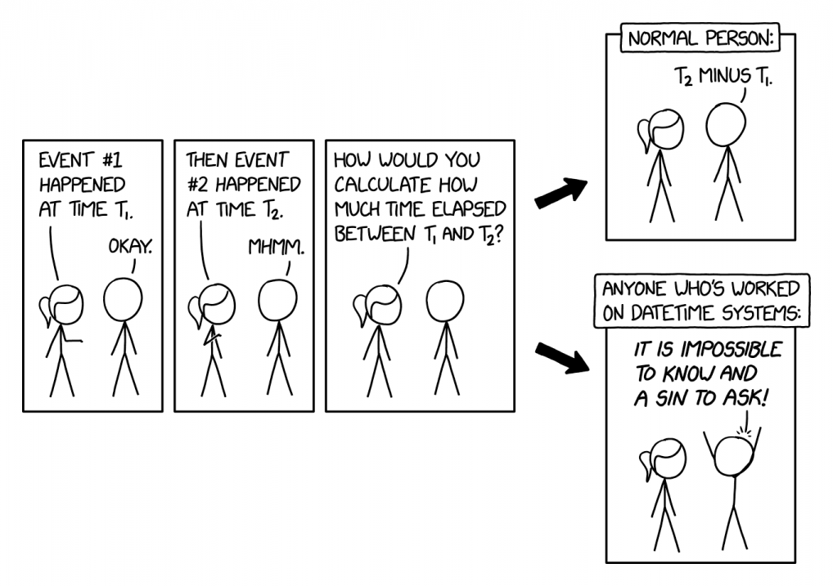
Software Engineering
Causality & Distributed Systems

Slide 2
Multi-Process With Users
So far:
Multi-process for performance reasons
Other uses too:
Geographically spaced backups
Improved latency for users

Slide 3
Multi-Process With Users
User 1, connected to Server 1, changes some state at time t₁
Ex: picking up an item off the ground in a game
User 2, connected to Server 2, wants to change the same state at time t₂
What should happen?

Slide 4
Clock Drift
By themselves, two servers can't provide a consistent ordering of events
in practice, clocks drift constantly
How to order events anyway?

Slide 5
Central Time Server
Use NTP (Network Time Protocol) to sync
Most common:
pool.ntp.org (or filtered versions)
time.nist.gov
This reduces clock drift into the millisecond range (typically 200-500ms), but doesn't completely eliminate it

Slide 6
Central Time Server
Sticking with the central server approach:
How to handle conflicting data due to (small, unusual) clock drift?

Slide 7
Central Time Server
Sticking with the central server approach:
How to keep all the servers in sync about the state of the world?

Slide 8
Logical Clocks
What if you don't have a central server?
Geographically remote locations
Air-gapped networks for security reasons
Intermittent connectivity issues
Very high latency connections
More common than you'd think (ex: Taiwan)

Slide 9
Logical Clocks
Any monotonically increasing sequence can be used as a clock
12:01 pm
12: 05 pm
1:10 pm
Or
t₁
t₂
t₃

Slide 10
Logical Clocks
Each server maintains a "logical clock" - the time only increases when something happens
Each server knows what order things happened on for that server
What problem does this cause?

Slide 11
Vector Clocks
Instead of one clock, keep a list of clocks. Now a "timestamp" looks like:
[server 1=t₁, server 2 = t₂]
For server 1, its entry is based on its logical clock
Every other entry is based on the "last time the server synced"

Slide 12
Vector Clocks
What do things "happening at the same time" look like in this system?

Slide 13
Vector Clocks
Common application: git
Instead of servers/logical clocks, git knows about branches and commits
One commit = one action
Commits are applied as diffs
Changes happening "at the same time" = merge conflict

Slide 14
Git
Which of the following will cause a merge conflict?

Slide 15
Git
main
abc
def
4g5
7k9
branch1
123
branch2
h6j

Slide 16
Git
main
abc
def
4g5
7k9
branch1
123
branch2
h6j

Slide 17
Git
main
abc
def
4g5
7k9
branch1
123
branch2
h6j

Slide 18
Resolving Conflicts
Treat an action as a "change" to the server state.
Ex: User picks up a block of dirt in Minecraft
ServerState initial: int gridValue = FLOATING_BLOCK_DIRT
UserAction userAction: () -> pickUpDirt();
ServerState newState = applyUserAction(initial, userAction);
newState: int gridValue = EMPTY

Slide 19
Resolving Conflicts
Treat an action as a "change" to the server state.
If the order in which changes are applied doesn't matter, there's no conflict:
applyUserAction(applyUserAction(initial, userAction1), userAction2)
==
applyUserAction(applyUserAction(initial, userAction2), userAction1)

Slide 20
Git
More semantic knowledge ⇒ better automated conflict resolution
Git knows about:
files
lines of text
It does not know:
how to compile Java code
whether or not whitespace matters

